Slide 1
ParAqua DB:
Last developments and next steps
Andrea Tarallo & Davide Raho
ParAqua Core Group and MC-Network Meeting
12-13 September 2024
Lyon - France

Slide 2
Original deliverable
D2.1 Interactive web page and on-line catalogue with the data collected from the Observatory and with an interactive blog that will be kept updated regularly with the opportunity to integrate info and interactive sharing of information by the users.
What were the needs of ParAqua?
A centralised gateway for the data
A tool that people can use to see when/why parasites occur in relation to «environmental» drivers
Extensible
Long-term maintained
Notes:
The original deliverable. In Cyprus we agreed

Slide 3
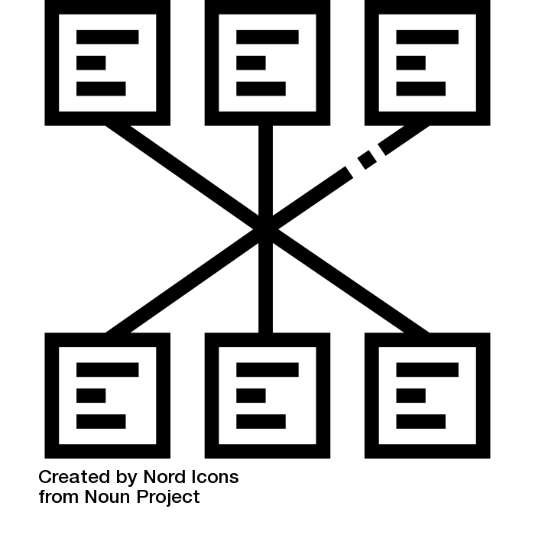
You want a relational database!
A centralised gateway for the data: all data are stored in a single place
A tool that people can use to see when parasites occur in relation to environmental drivers: the database can be queried and filtered for specific variables or intervals
Extensible: tables can be extended in N of data and in N of variables
Long-term maintained: LifeWatch is long-term maintained (for at least ten years, and hopefully until I retire)
RELATIONAL DATABASE by Nord Icons from thenounproject.com (CC BY 3.0)

Slide 4
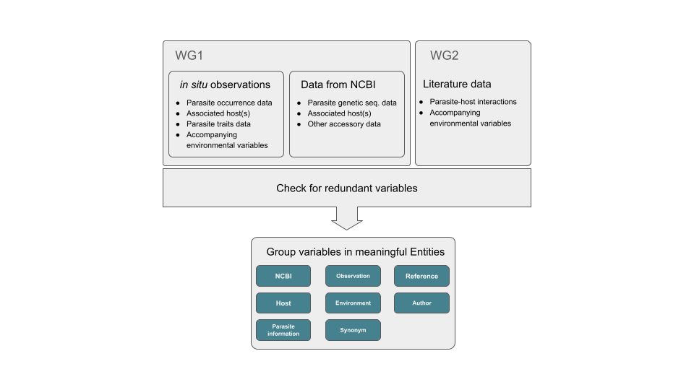
Where we are
In progress
Data ok
Paper submitted
In progress
Paper in preparation:
Tentative title
Field observations of zoosporic parasites infecting aquatic primary producers
Tentative LoAs
Rasconi, S., René, A., Gsel, A.S., Kraberg, A., Dimova, M., Mc Kindles, K., Van den Wyngaert, S., Frenken, T., Rosati, I., Tarallo, A…others?
From unstructured data
to
structured data

Slide 5
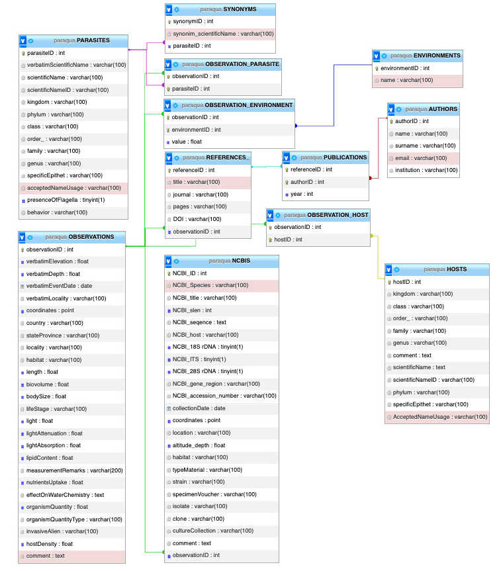
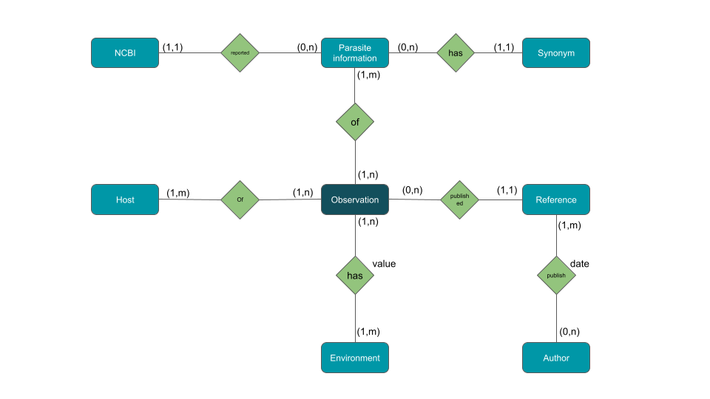
From structured data
to
querable data*
*by expert users
Giuseppe Turrisi VM Grant
Paper RIO

Slide 6
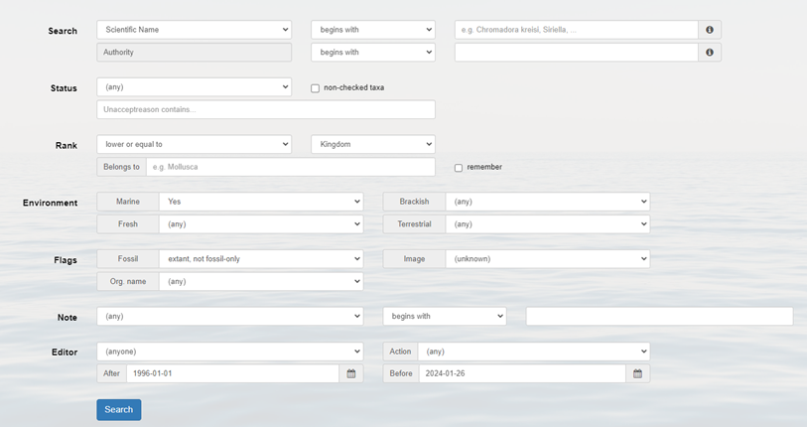
Where we want to go
From querable data
to
graphical user interface
Multiple steps process
Davide Raho VM Grant

Slide 7
What has been done
Setting Up the DB
Testing and upload with real data
Debug DDLs and adjust the RE Model
Build and Test main queries
Build the GUI and test
Prototyping the backend
Build the connection between frontend and backend

Slide 8
Backend
Easily Deployable: compatible with most shared hosting services, VPS, and cloud hosting providers.
Low demanding on resources (2 vCPU, 4 GB RAM)
Microservices architecture for: Scalability, Modularity and services orchestration.
Security strategies implemented

Slide 9
Frontend
Component-based architecture for reusability and modular design
Maintainable and Scalable
High Performance thanks to Virtual DOM
Responsive Interface

Slide 10
Frontend – WEB GUI
Designed to maximize the user experience while performing a search
Single Page Application
Optimised for mobile and desktop devices
Dynamically transforming search page
Dynamic Table visualisation
Downloadable data.CSV files

Slide 11
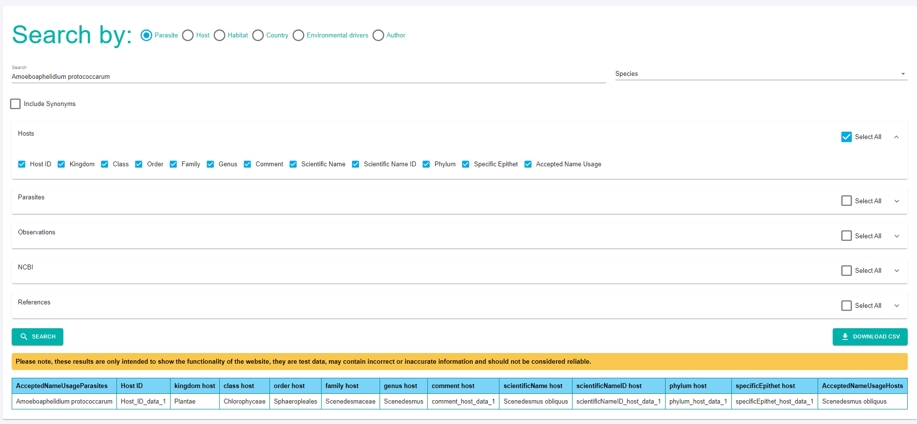
Testing webpage
www.paraquadb.cloud

Slide 12
Current challenges
Refining Database structure:
experimental observation attribute?
{freshwater / marine / industrial}
{natural / industrial / experimental}
{marine, freshwater, industrial} + Experimental
Refining search workflow :
ex. Search on a single taxon or across all ranks?
Refining data output:
Handling one-to-many relationship
Single observation in multiple lines
(authors, environmental parameters)

Slide 13
Current challenges
Refining data output:
Handling one-to-many relationship
Single observation in multiple lines
(authors, environmental parameters)

Slide 14
Next steps?
Work on the frontend contents
Backend in production
Deploy on LifeWatch server
Make data available as open and FAIR
Long term sustainability plan?

Slide 15
Possible future implementations
Enhancing Usability and Interoperability:
GUI for uploading and updating data
Open API for data retrieval

Slide 16
Thank you!
andrea.tarallo@cnr.it
davide.raho@cnr.it

